Slide 1

Assalamu-Alaikum
بِسْمِ اللَّهِ الرَّحْمَنِ الرَّحِيم

Slide 2
Welcome to our Software Project Presentation

Slide 3
Course Name : Software Development 1
Course Code : CSE-2340
Section : 3BM
Semester : 3rd
Team : HHJN
Project : IIUC Bus Management System
Course Teacher : Sazid Khan
Lecturer , IIUC

Slide 4
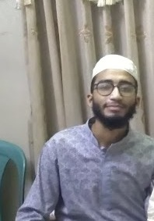
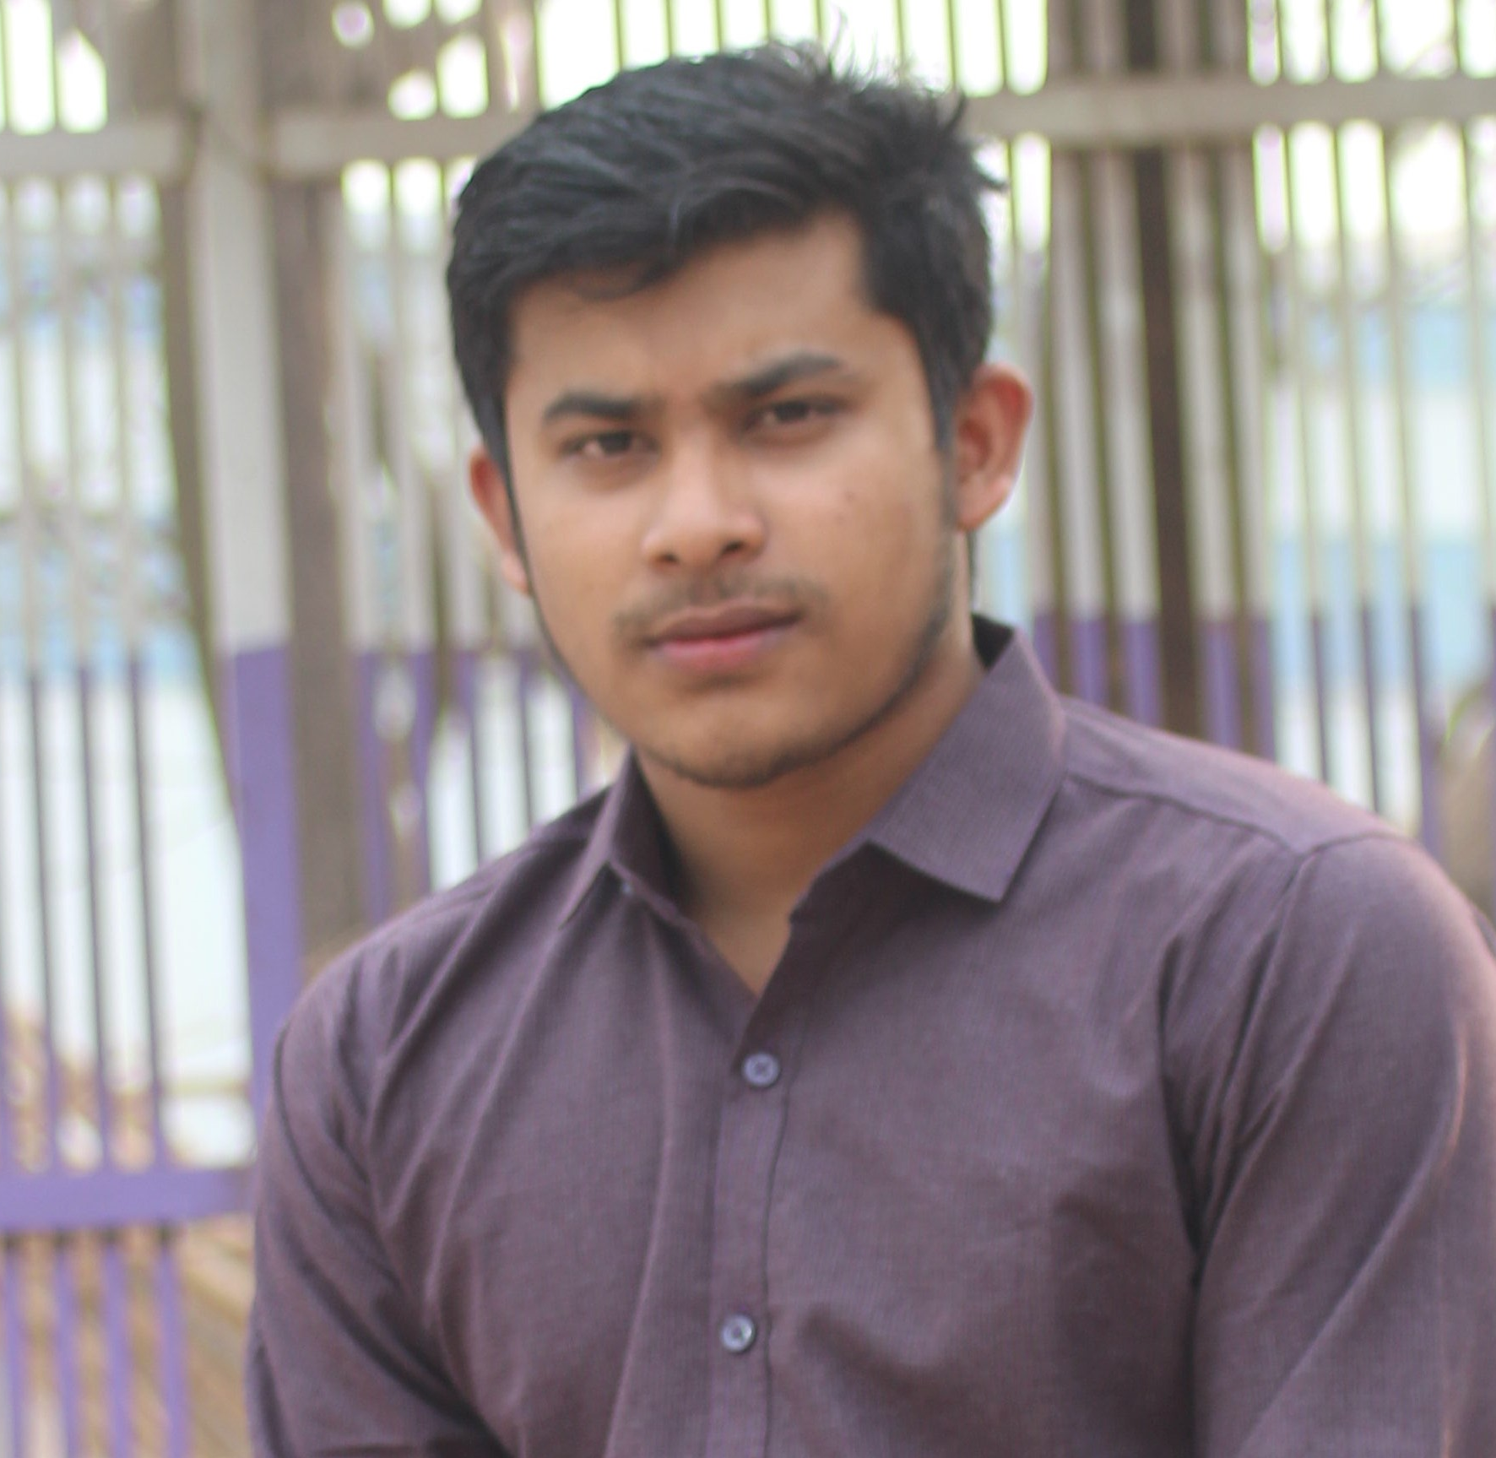
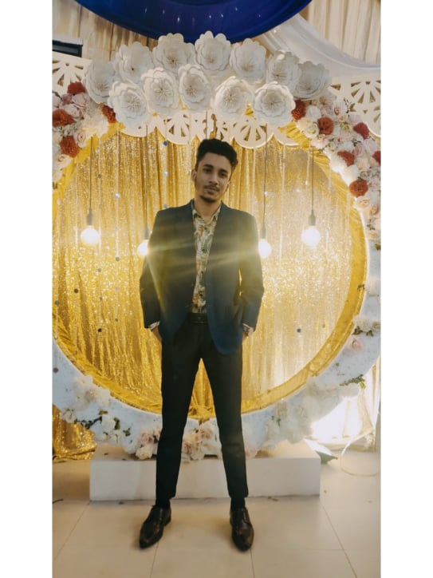
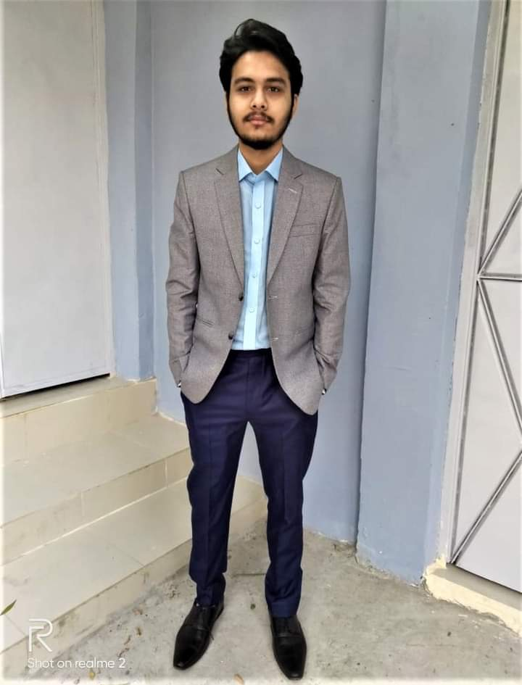
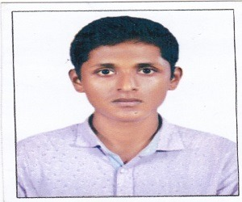
Tahsin Abrar
ID : C193084
Email : towahatahsin01@gmail.com
Mobile : 01830986335
Nimur Rashid Imon
ID : C193066
Email : naimurrashed@gmail.com
Mobile : 01706610237
Al Rafi
ID : C193079
Email : montasirrafi@gmail.com
Mobile : 01869366907
Mohammad Rahatul Islam
ID : C193075
Email : islamrahatul2019@gmail.com
Mobile : 01869599022
Md.Rafidul Islam
ID : C191065
Email : rafidulislam3549@gmail.com
Mobile : 01884213549

Slide 5
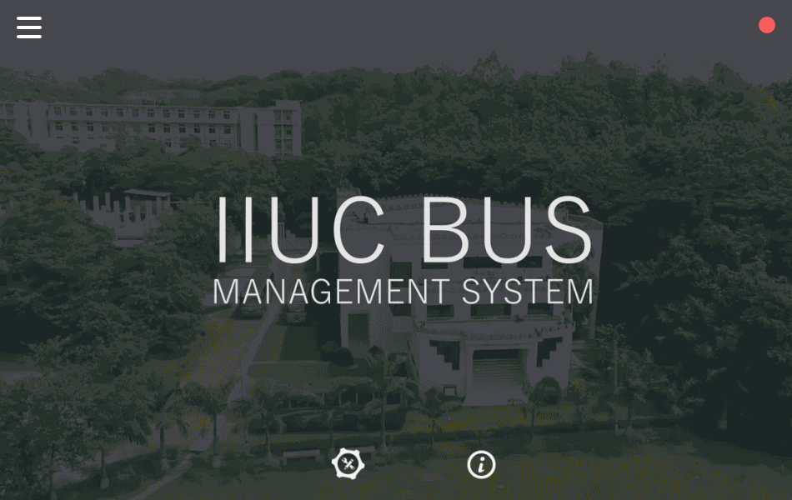
Starting Interface

Slide 6
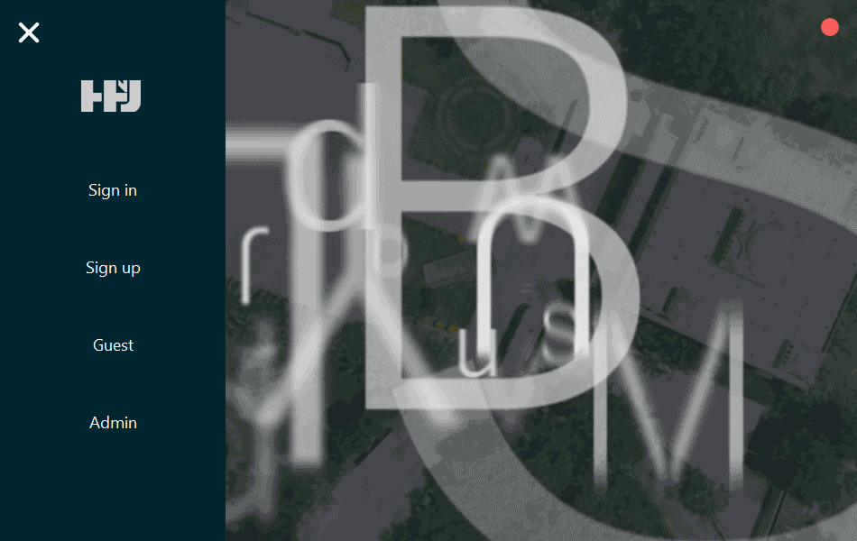
Main Menu

Slide 7
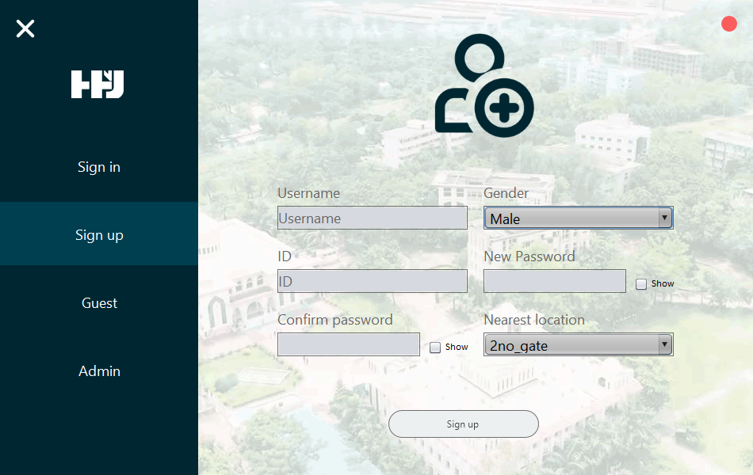
Sign-up Interface

Slide 8
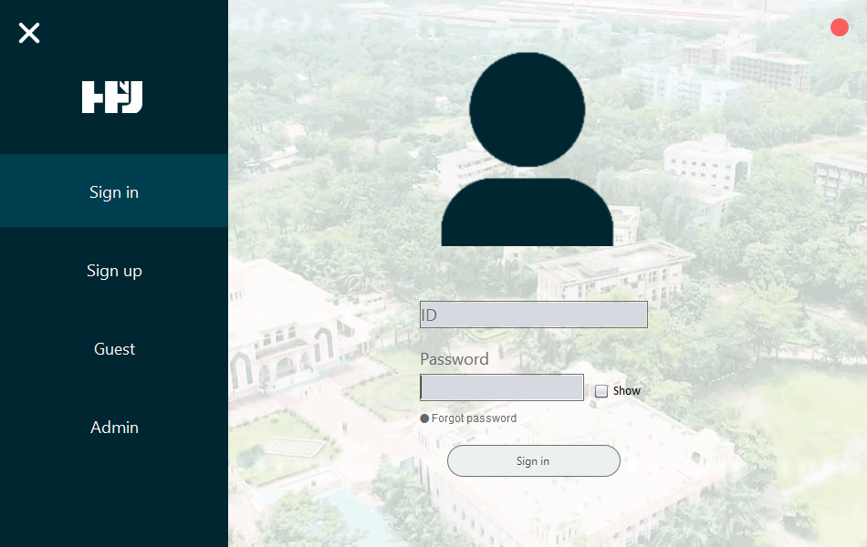
Sign-in Interface

Slide 9
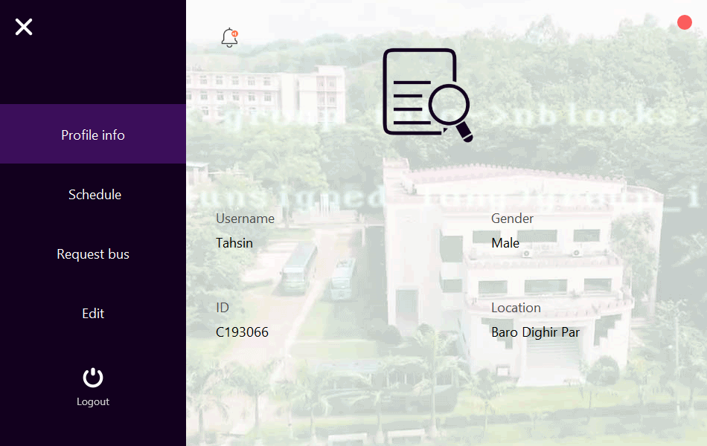
User Profile

Slide 10
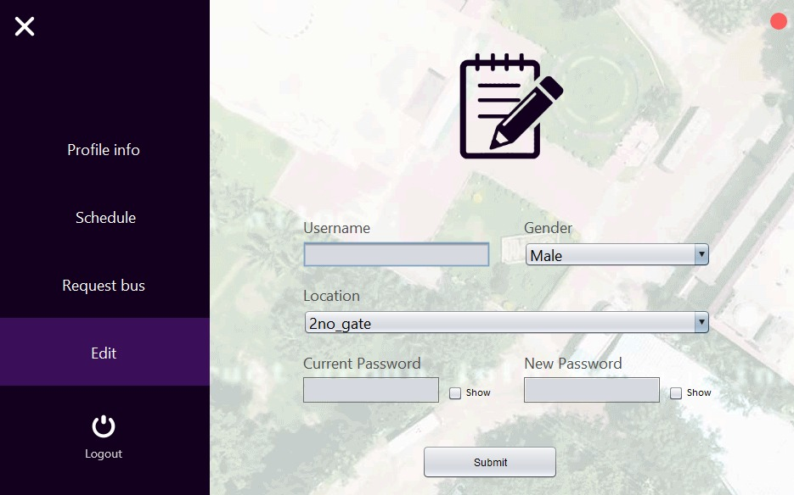
Edit Profile

Slide 11
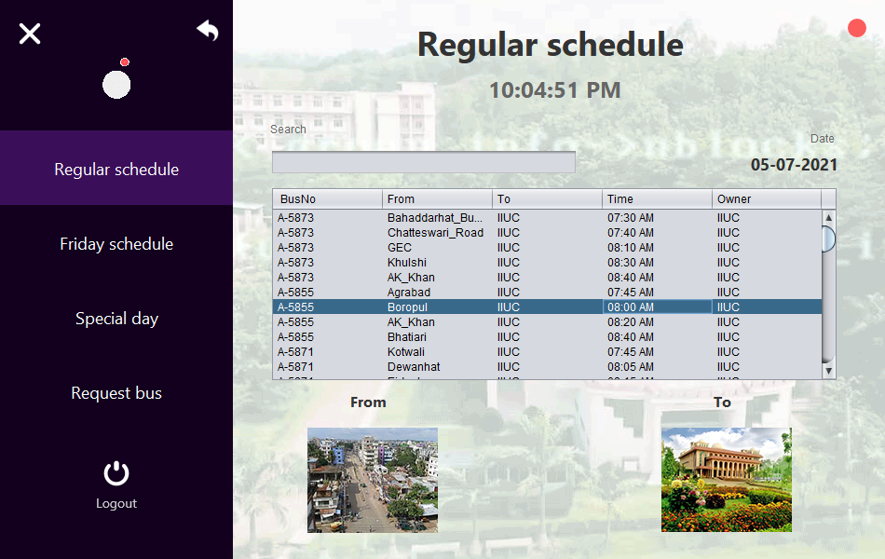
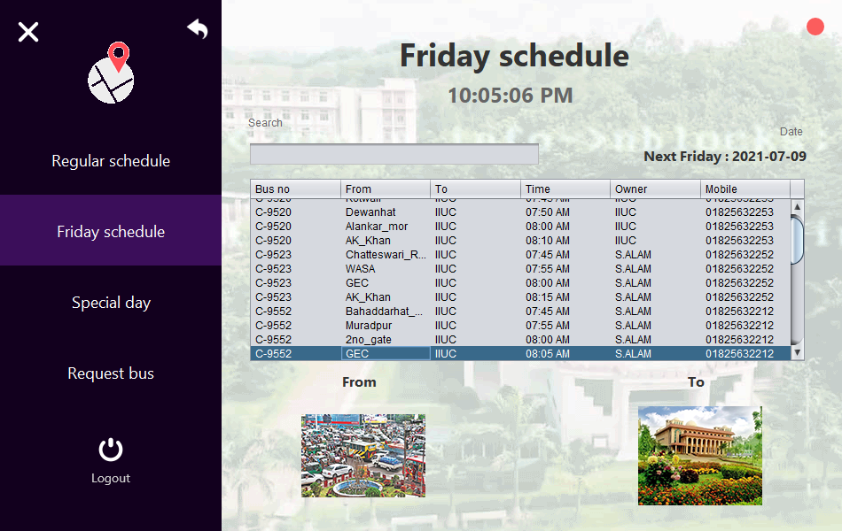
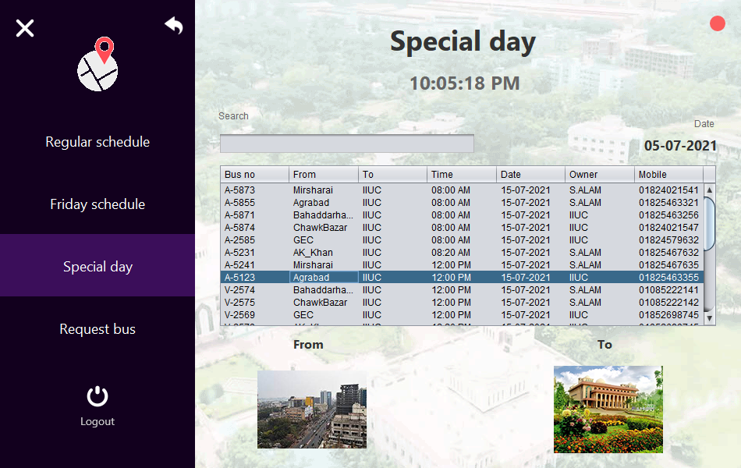
Schedule Page

Slide 12
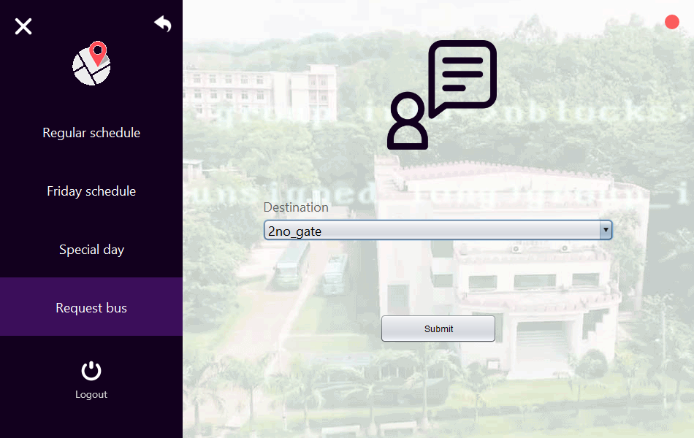
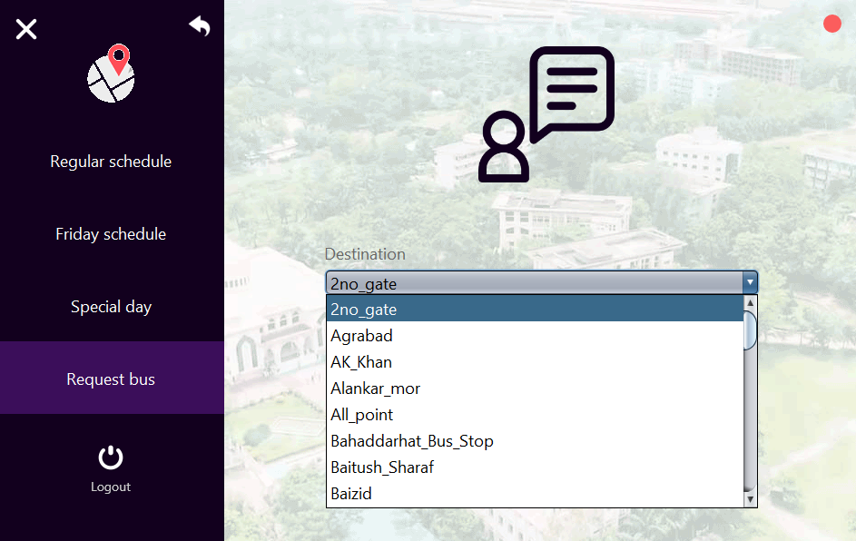
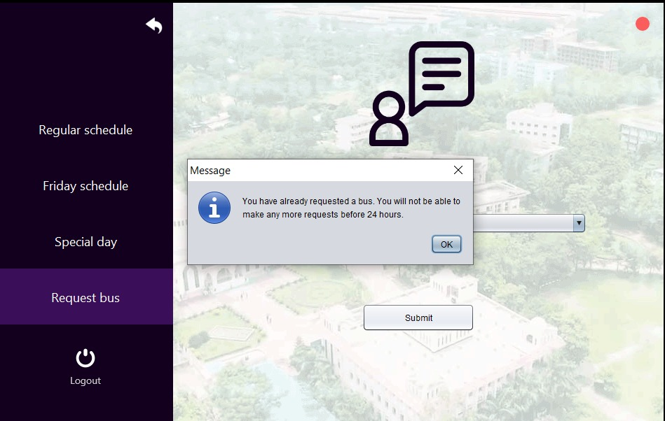
Bus Request Interface

Slide 13
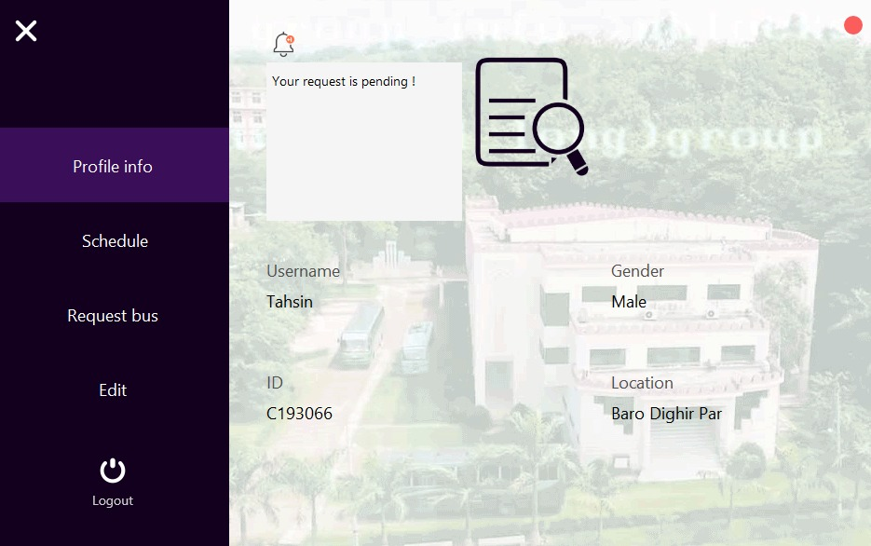
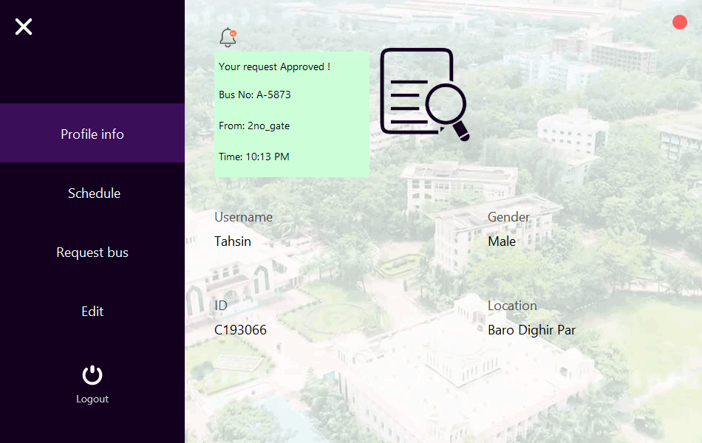
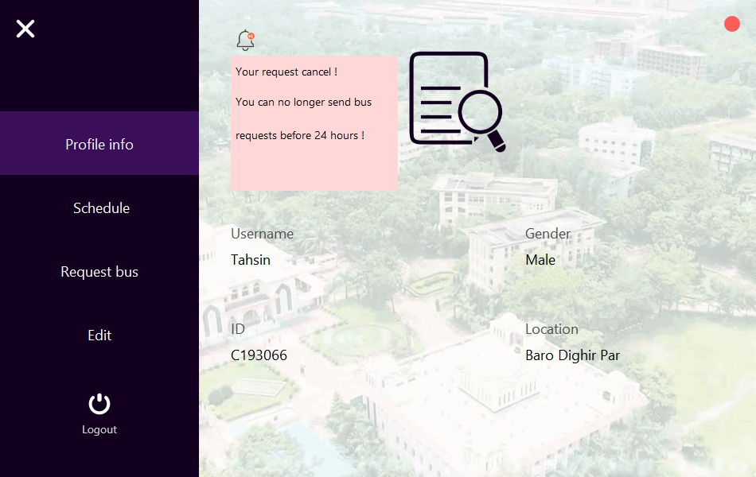
Bus Request Notification

Slide 14
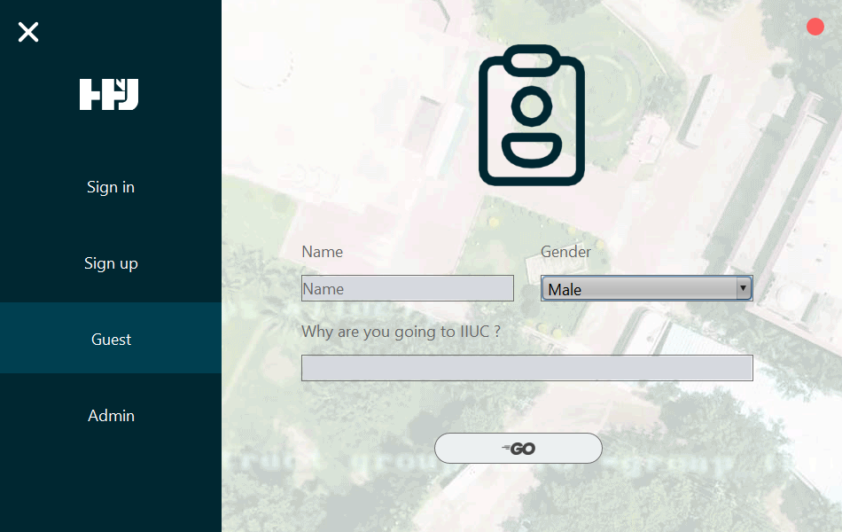
Guest Interface

Slide 15
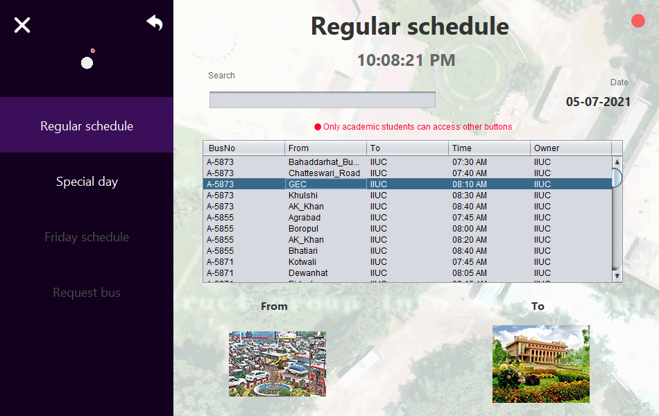
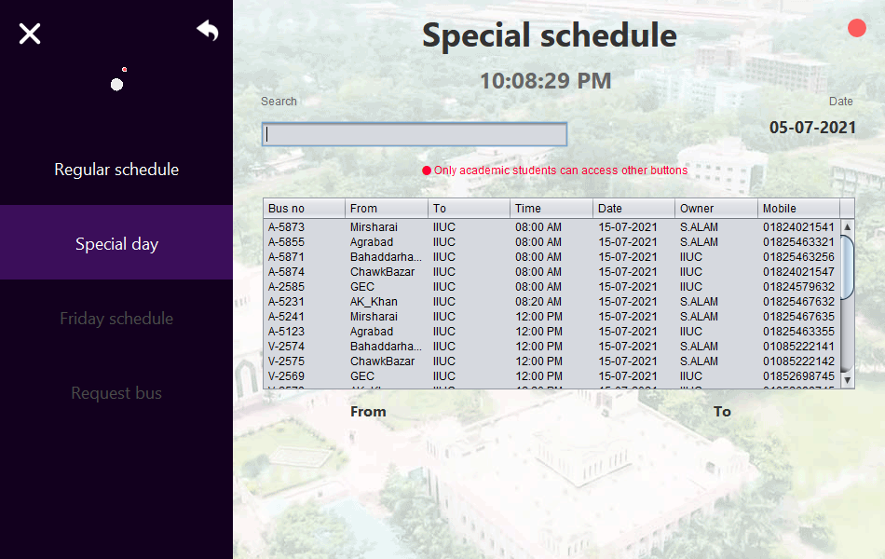
Guest Schedule

Slide 16
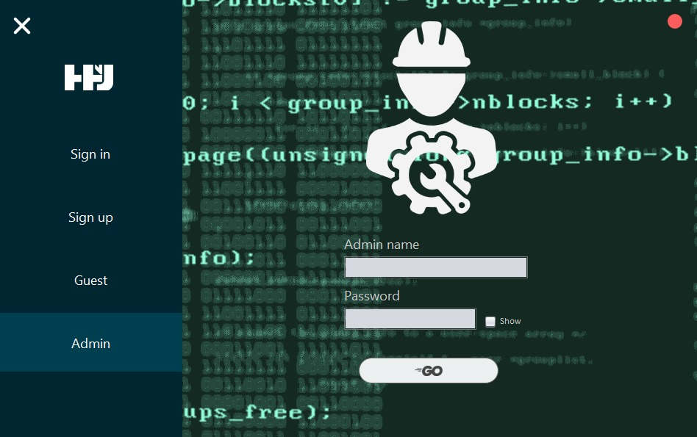
Admin Login Interface

Slide 17
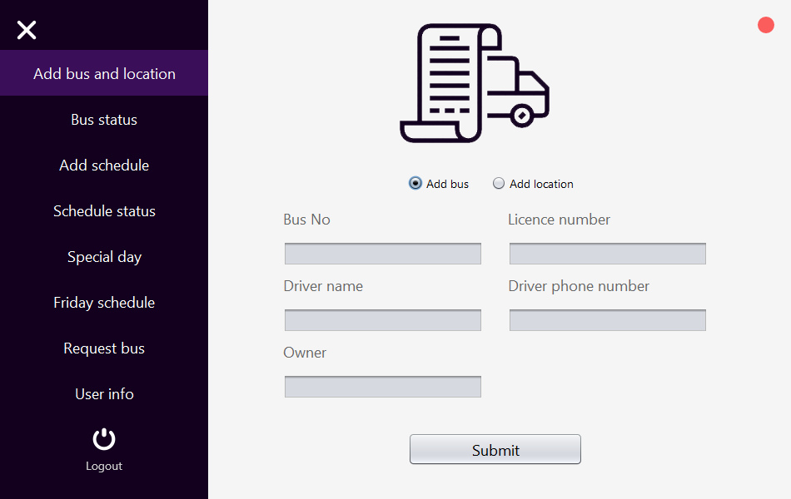
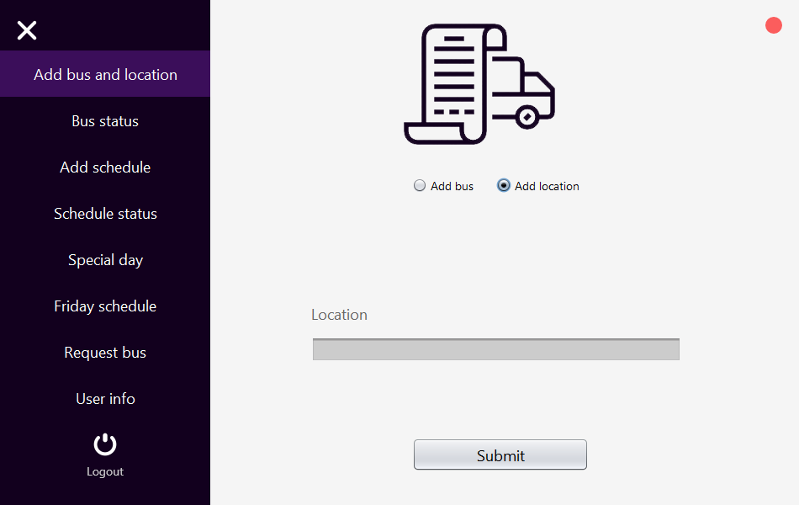
Admin System

Slide 18
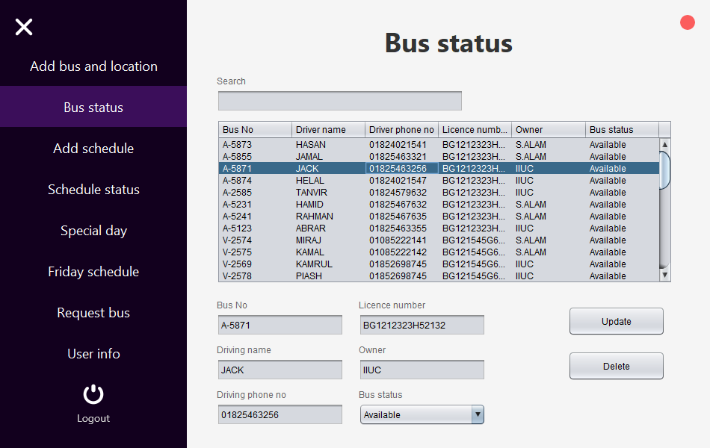
Admin System

Slide 19
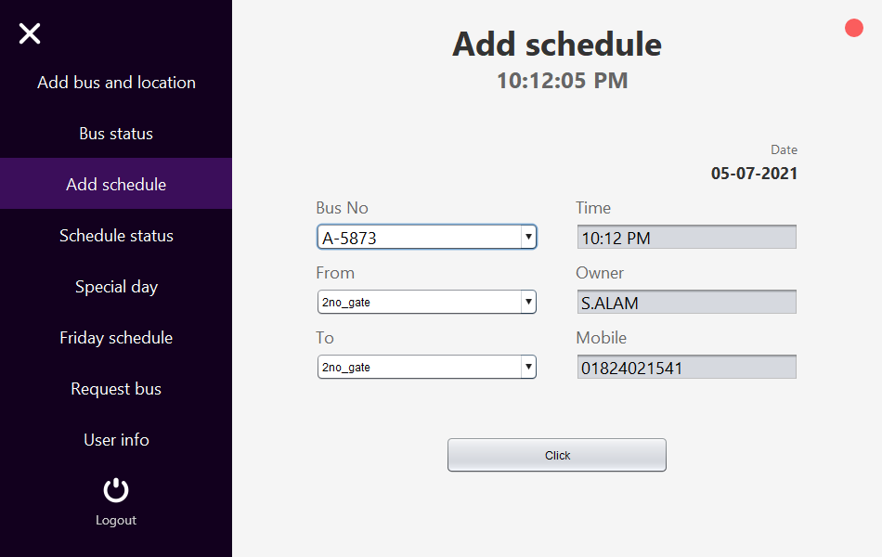
Admin System

Slide 20
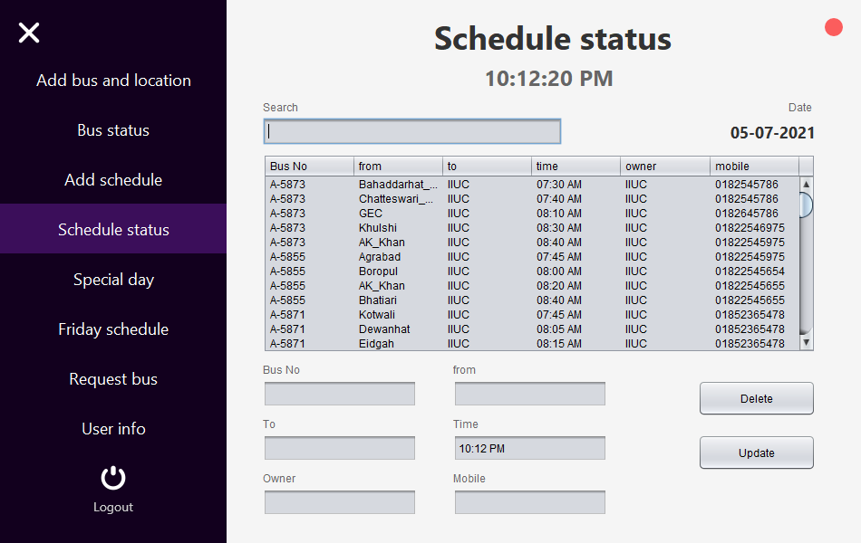
Admin System

Slide 21
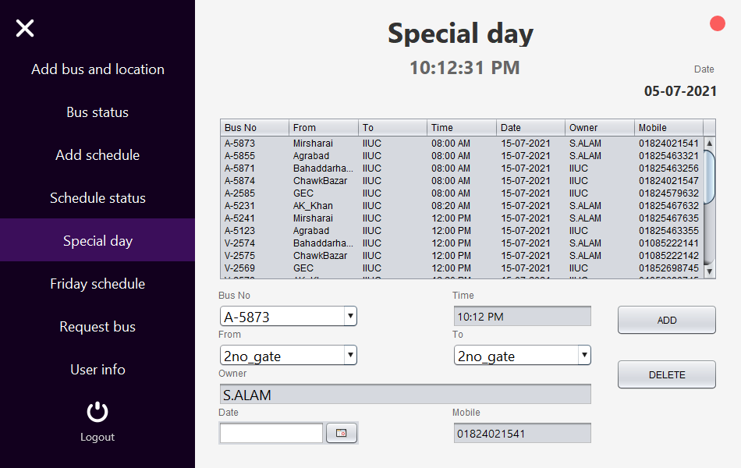
Admin System

Slide 22
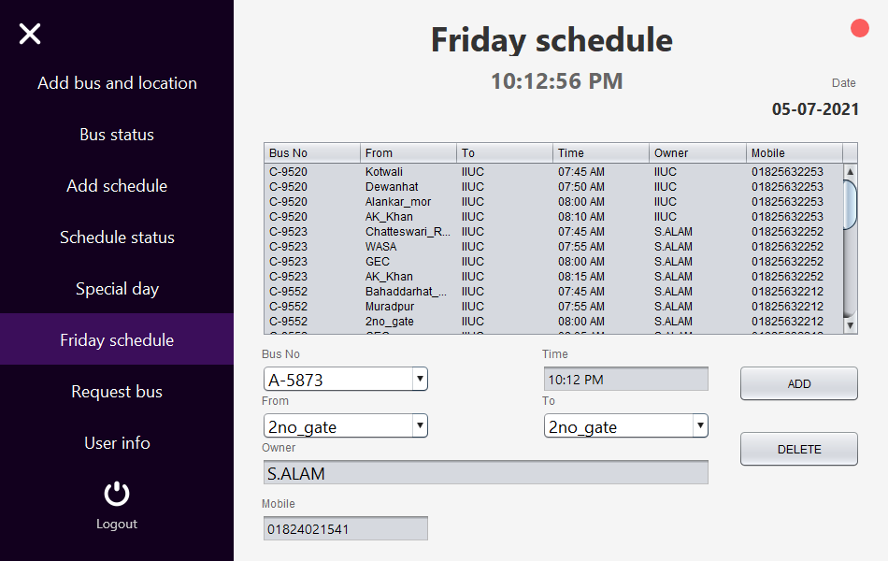
Admin System

Slide 23
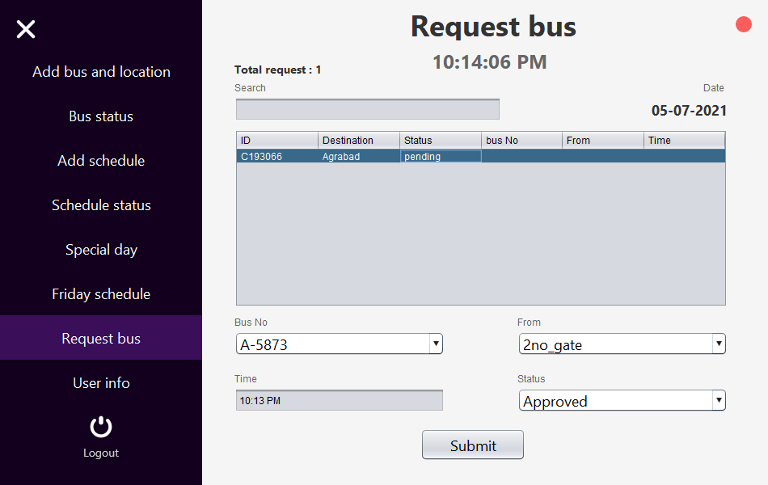
Admin System

Slide 24
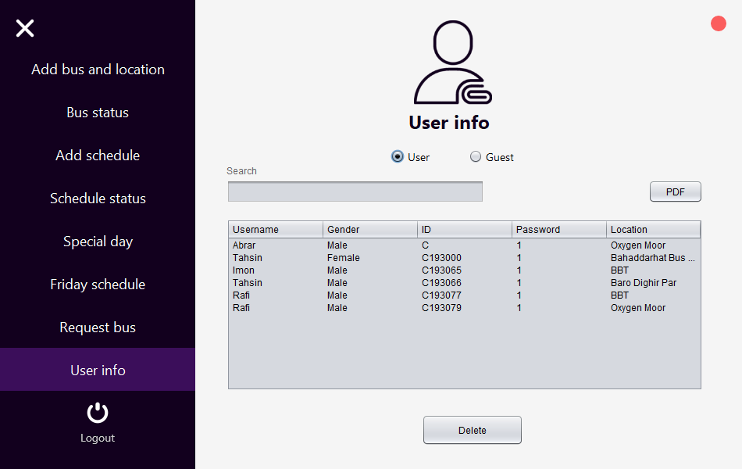
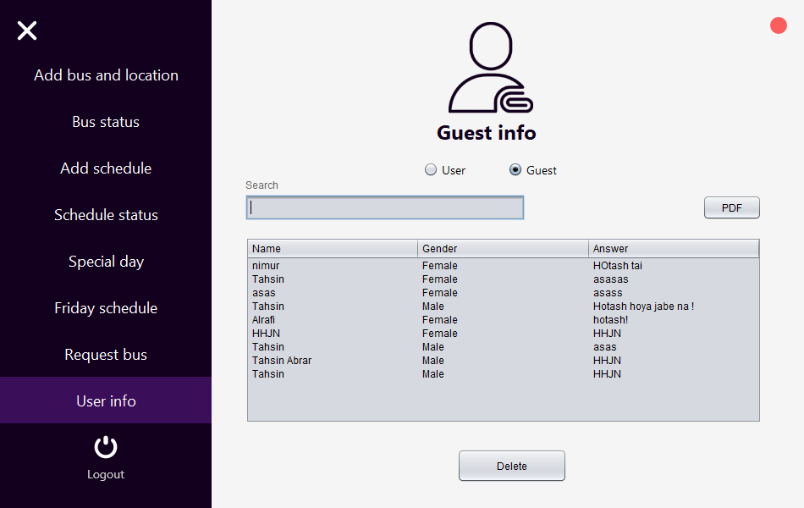
Admin System

Slide 25
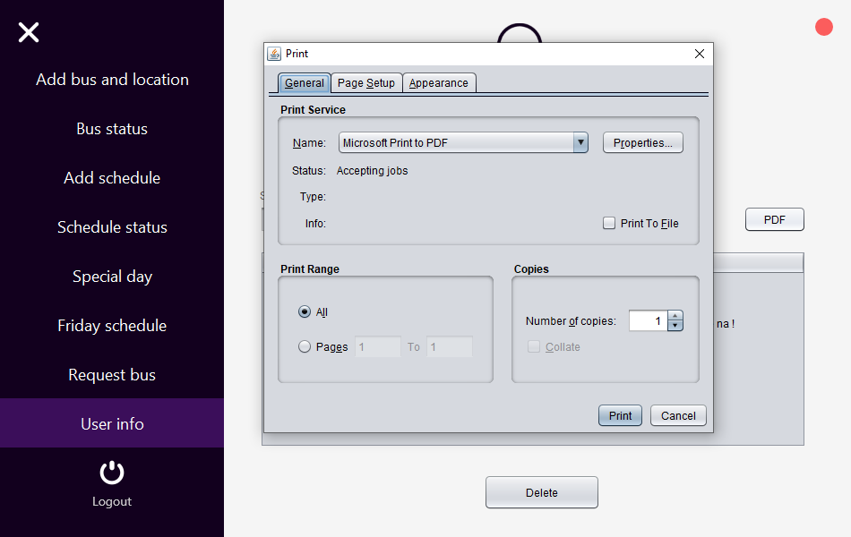
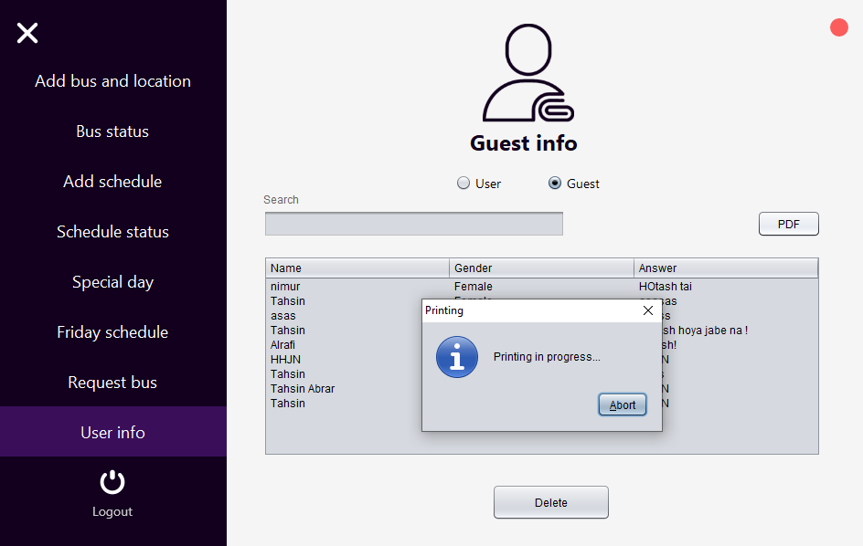
Admin System

Slide 26
THANK YOU

